Slide 1
Linguistic Pipeline EEG

Slide 2
Phonetic Level
Forced alignment of audio transcription using webMAUS, followrd by manual verification with Praat
https://clarin.phonetik.uni-muenchen.de/BASWebServices/interface/TextAlign
Features:
Phoneme onset
Phoneme offset
Token onset
Token offset
Additional features ?

Slide 3
Pre-processing
Text Tokenization The content in .txt format is processed and segmented into individual linguistic units (tokens). Each token is stored on a separate row within the dataset.
Punctuation removal In this step, punctuation can be removed from the text.

Slide 4
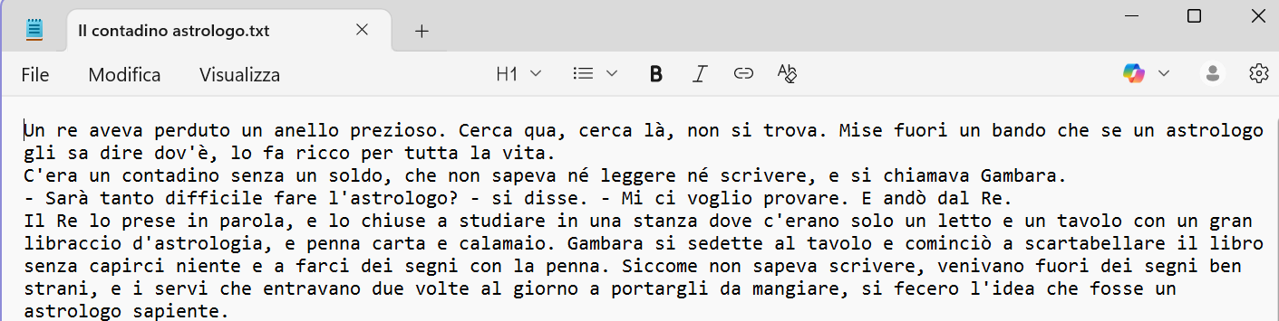
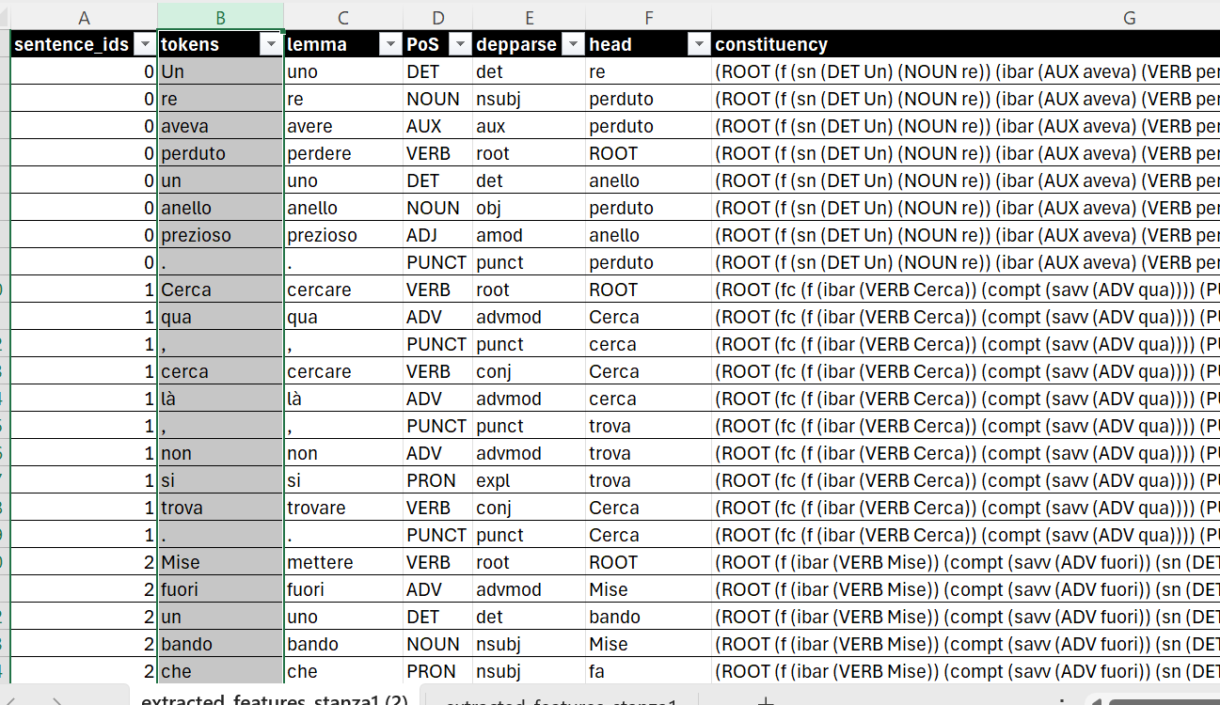
Notes:
Domanda 1 → meglio tutte le featrures in un unico csv/excel oppure un foglio = una feature?

Slide 5
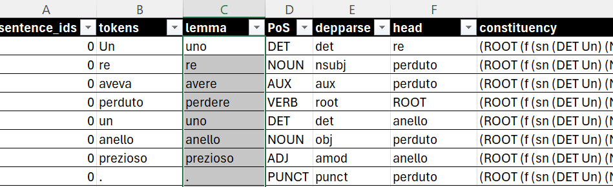
Lexical Level
Lemma Extraction
Lemmatization reduces words to their base or dictionary form, helping unify variations like ‘vado’, ‘andai’, and ‘andato’ into ‘andare’.
Lemmatization is useful for topic modeling, frequency analysis, and improving Named Entity Recognition (NER).

Slide 6
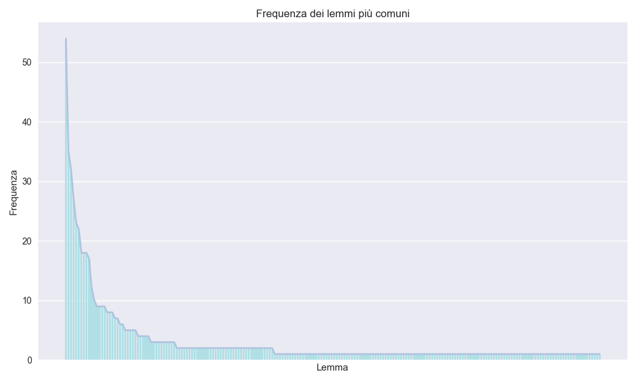
For example, thanks to lemmatization we can observe the distribution of words in a text and highlight Zipf’s empirical law, which shows that a few words occur very frequently while the vast majority appear only rarely

Slide 7
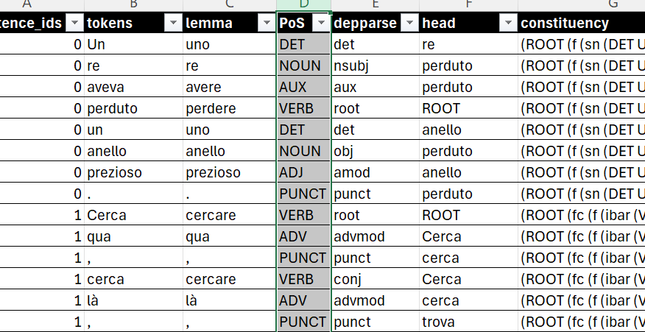
Syntactic Level
PoS (Part-of-Speech) Tagging is the process of automatically assigning each word in a text its grammatical category, such as noun, verb, adjective, or adverb.

Slide 8
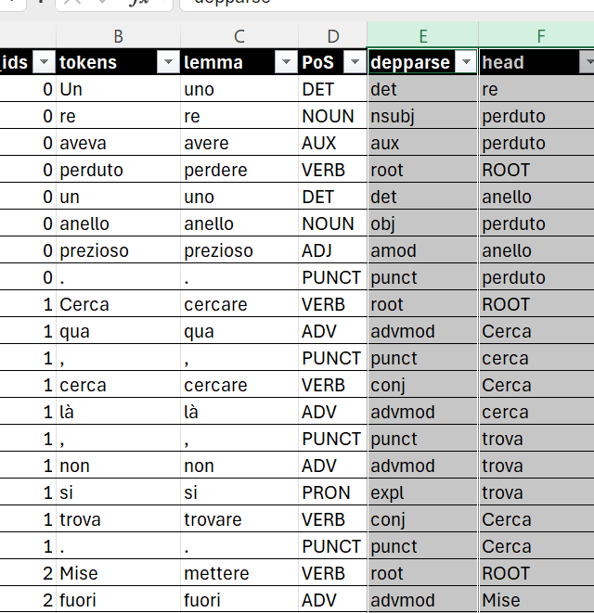
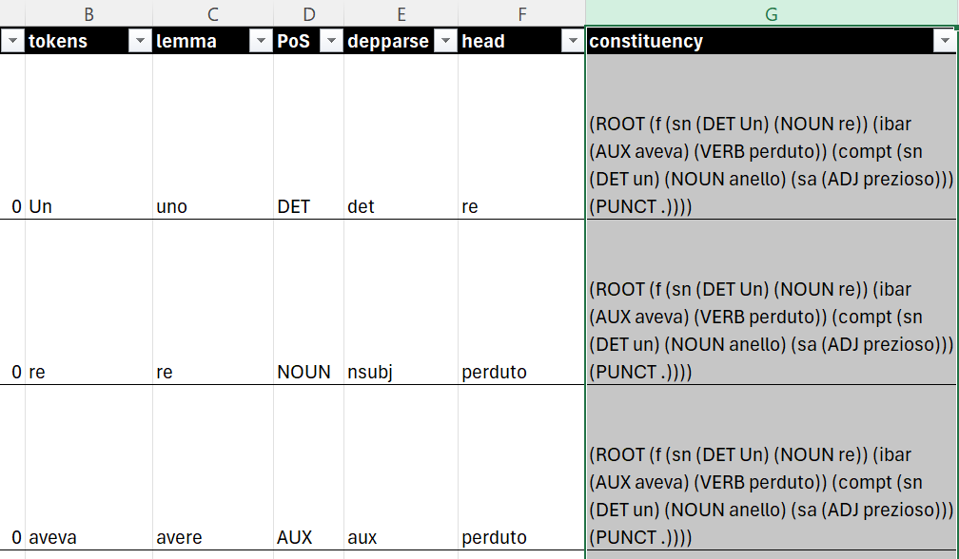
Syntatctic structure of sentence:
Dependency parsing analyzes the grammatical structure of a sentence by identifying relationships of dependence between words. Each word is linked to a ‘head’ that governs it. This approach highlights who depends on whom in the sentence.
Constituency parsing breaks a sentence into phrases or consituents, such as nous phrase (NP), verb phrase (VP) and prepositional phrases (PP). The result is a hierarchical tree.

Slide 9
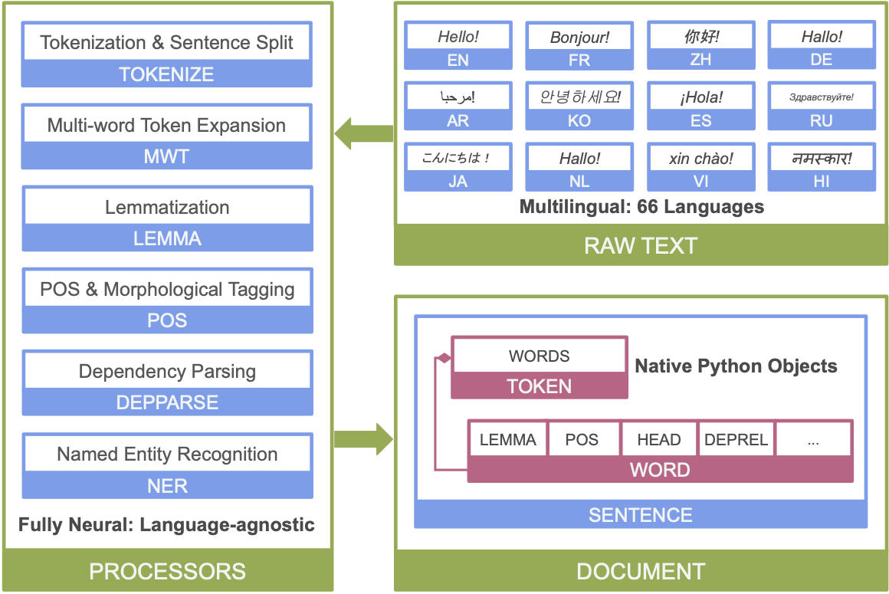


Python Library = STANZA https://stanfordnlp.github.io/stanza/
The MWT processor in Stanza handles multi‑word tokens, which are single surface forms that actually correspond to multiple underlying words (della = ‘di + la’)
Named Entity Recognition (NER) identifies and classifies proper names, locations, dates, or numerical values. For instance, in the sentence “Barack Obama was born in Hawaii”, NER labels “Barack Obama” as a Person and “Hawaii” as a Location

Slide 10
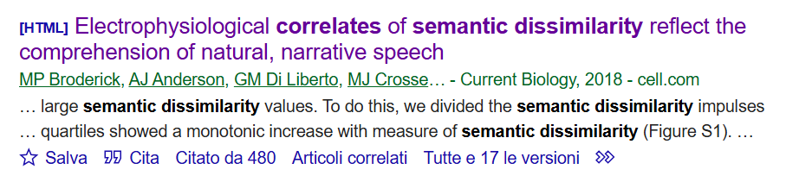
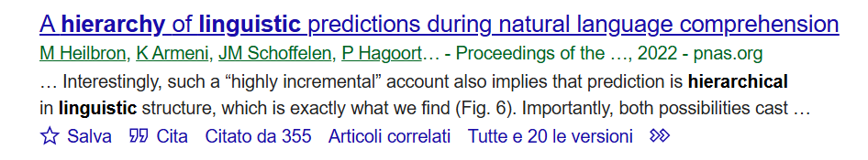
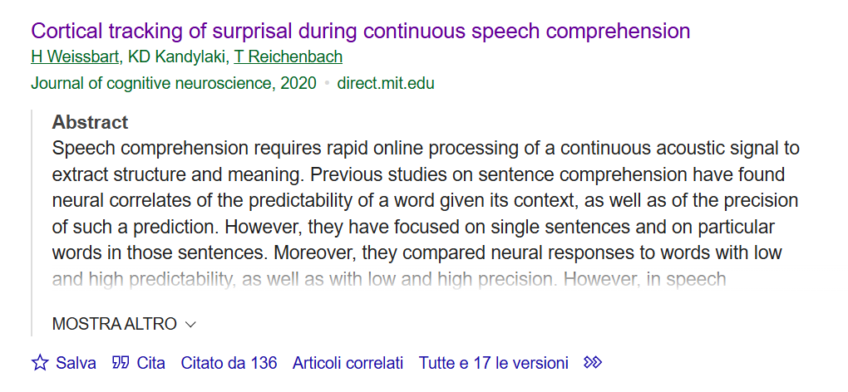






SURPRISAL - LLM

Slide 11
Semantic (dis)similarity
surprisal
Continous Speech Comprehension
N400
entropy
Predictive brain

Slide 12
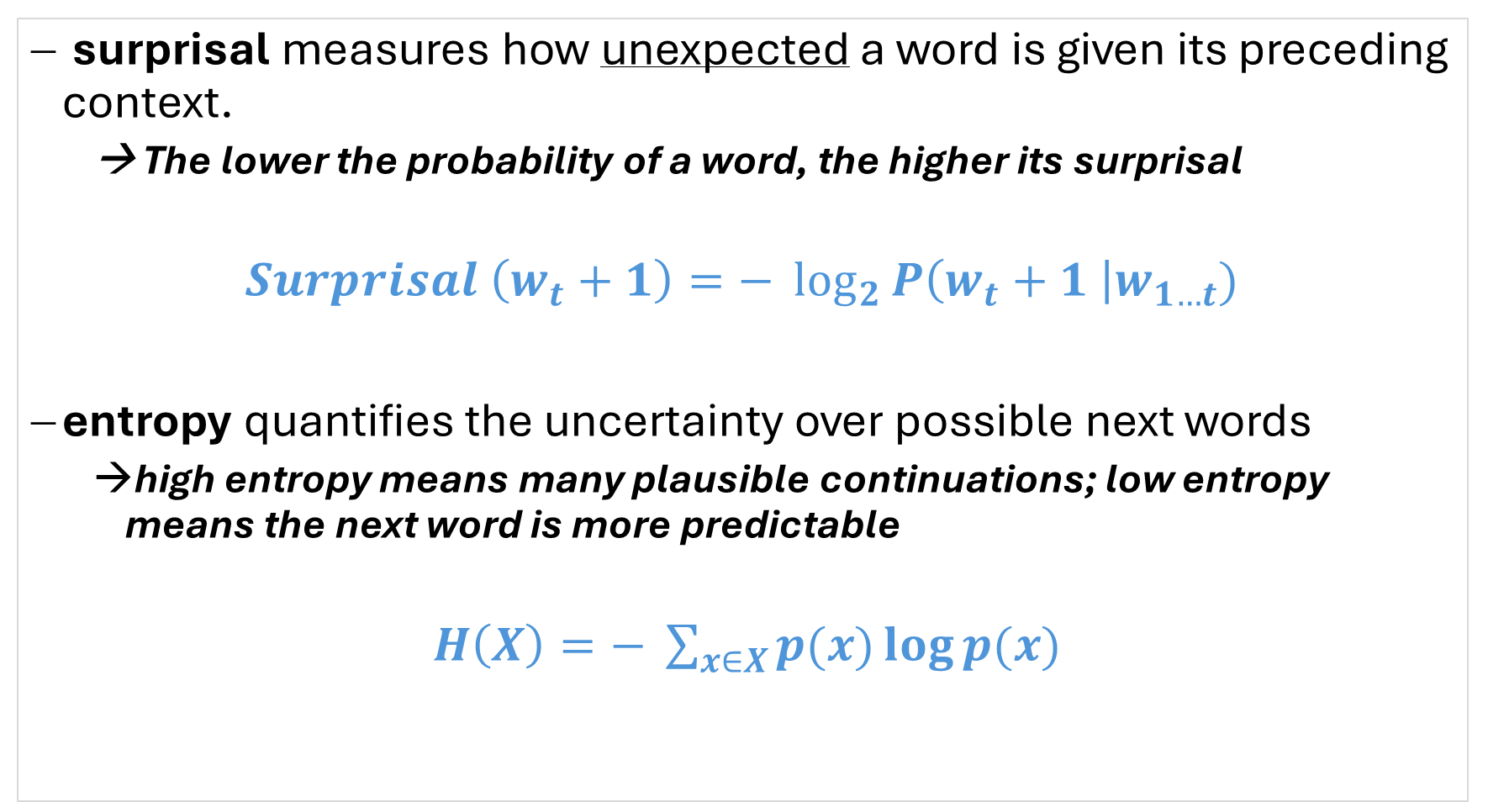
surprisal measures how unexpected a word is given its preceding context.
→ The lower the probability of a word, the higher its surprisal
$$Surprisal \left(w_{t}+1\right)=− \log_{2}{P\left(w_{t}+1 \right|w_{1…t})}$$
entropy quantifies the uncertainty over possible next words
high entropy means many plausible continuations; low entropy means the next word is more predictable
$H\left(X\right)=− \sum_{x∈X}{p(x)\log{p(x)}}$

Slide 13
Semantic similarity measures how close in meaning two words, phrases, or sentences are.
Two words or sentences are represented as vectors \vec{A} and \vec{B} in a semantic space (e.g., from word embeddings like Word2Vec, GloVe, or contextual embeddings like BERT), then we can obtain Cosine Similarity
Semantic dissimilarity measures how different in meaning two words, phrases, pr sentence are. It reflects the degree to which theri concepts or contexts diverge. We can compute the Cosine Dissimilarity using semantic vectors.
There are also other measures to compute the distance within two or more vectors.

Slide 14
LLM – Probability
The Transformer models (GPT, BERT, T5, etc.) have been trained as language models. This means they have been trained on large amounts of raw text in a self-supervised fashion (→ Large Language Model).
This type of model develops a statistical understanding of the language it has been trained on.

Slide 15
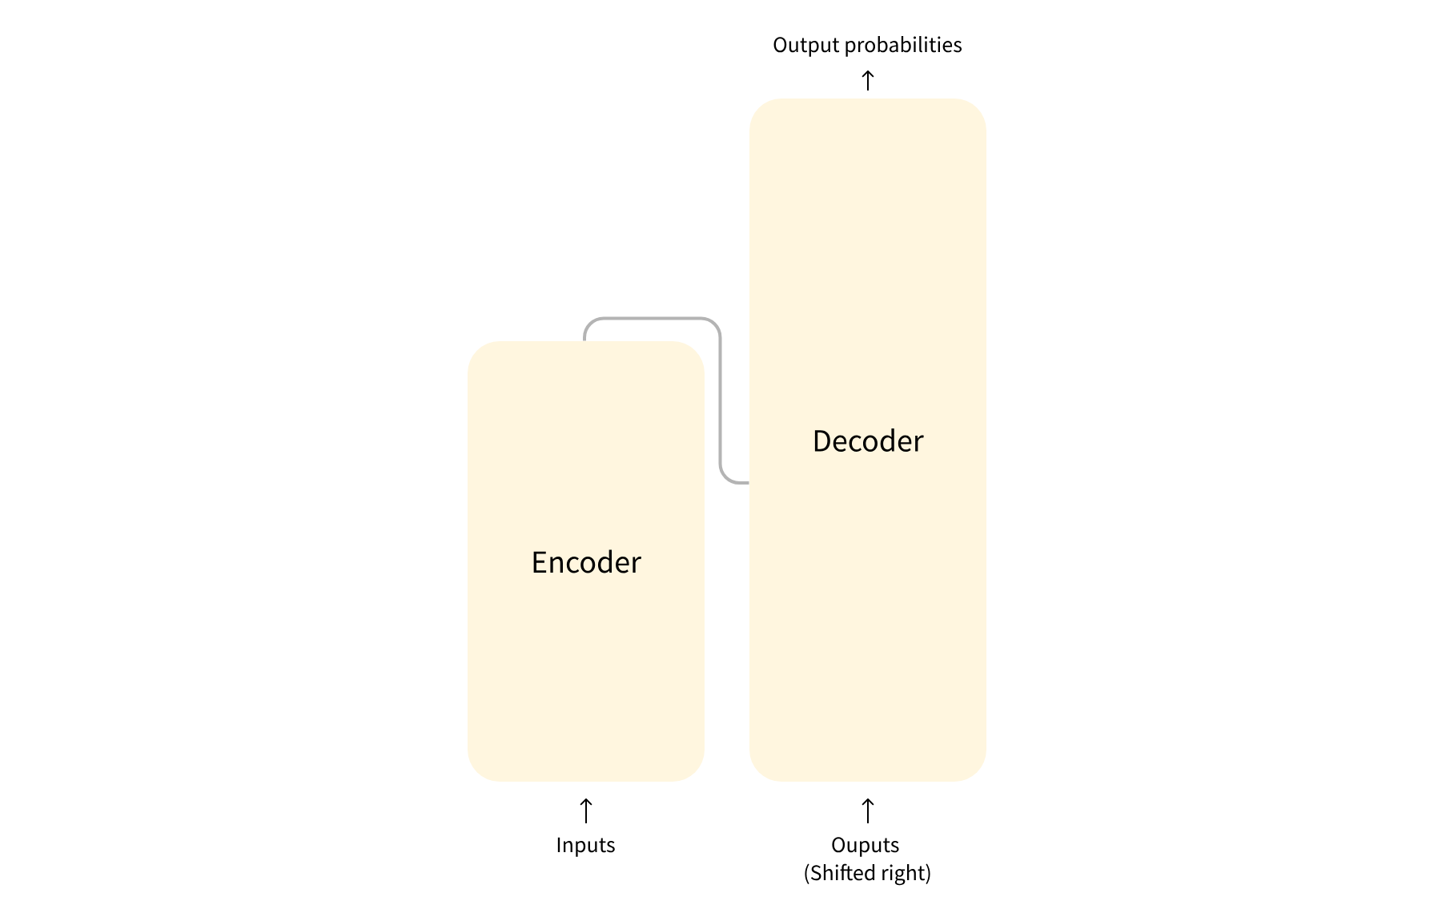
The Transformer architecture consists of two main blocks: an encoder and a decoder, originally designed for machine translation. The encoder, used in models like BERT, reads the entire input sentence at once and is non-causal, meaning it can look both forward and backward in the sentence. It’s trained on tasks like masked language modeling, where some words are hidden (e.g., “La [MASK] è matura”) and the model learns to predict the missing word (“pesca”). This makes it ideal for text classification, sentiment analysis, and question answering. The decoder, used in models like GPT, is causal — it only sees the words before the current position. It’s trained on causal language modeling, where the model predicts the next word in a sequence (e.g., given “La pesca è”, it predicts “matura”). This setup is perfect for text generation, summarization, and dialogue systems. These two blocks can be used separately or combined depending on the task: encoders are great for understanding, decoders for generating.

Slide 16

We can use these output probabilities to compute:
Lexical surprisal
Syntactic surprisal (PoS)
Semantic surprisal? We need to use contexutal word embedding from an Encoder model like BERT

